Slide 1
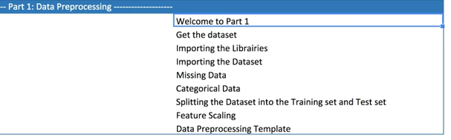
DATA PREPROCESSING STEPS
Welcome to the step-1: Data preprocessing and this is the crucial steps the journey of making a machine learing models. If there is no data preprocessing then your machine learning model wont work
E.g - if you going for long trip you are packing your luggage and make a plan for food, cloth, room booking . So if your preplaned in correct way then your trip would be enjoyable or else it will make you problem if you forget anything

Slide 2
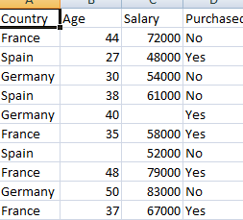
HOW TO DOWNLOAD THE DATASET
Multiple way you can download the dataset and you can do it from google or kaggle, but for real time scenario you have to build the the dataset from different way and we will discuss later regarding the real time scnario
Simple dataset is contain 4 column & 10 observation. Dataset explains about company & country information, product is purchased or not by the customer along with the salary. So we have to distinguish very important thing
What is independent variable is fist 3 columns and dependent variable is last column & in any Machine learning we will use inde var to predict the depe and in this dataset we will find out the customer is purchase the product or not
This is very important to build ML models

Slide 3
IMPORT THE LIBRARIES USING PYTHON & IMPORTING THE DATASET
Importing the library – What is Library? Library is interal system building tools to use make specific job. You just give i/p and Librarie will gives you the output.
1st library which is very essential NUMPY – system build mathmetical tools and any type of mathmetics code , since Machine learning is mathmetic codes absolutely need numpy and we create a short cut key (import numpy as np) the reason why we assigned short cut key because for entire programme we don’t write numpy instead of that we can type just np.
2nd essential library is matplotlib is for visualization can done by stats so machine could visualize the coding & it will show the plot diagrams and you can more understand later
3rd essential lib as PANDAS – best library to import and manage the dataset using dataframes
IMPORTING THE DATASET
Importing the dataset you need directory which you stored downloaded dataset
After select the go to variable explore you will find out the dataset right side of the window
Remember in python index always starting from 0 in R index starting from 1
Next we going to create matrix of 3 independent features – X & we will create dependent variable also as y
: means selecting all lines , :-1 means all columns except last one

Slide 4
MISSING DATA,TRAINING &TESTING,FEATURE SCALING
In given dataset 2 missing data found as this is small data we cannot remove the observation or line so we will found the mean
In this case we will use scikit learn package which is very very important , entire machine learning we will use SCIKIT
Sklearn-scikit learn, from sckit learn import library imputer class which allow us to take care of missing data
Create object imputer and replaced mean value with NaN and we will check in the google sheet
Given dataset country and purchase are 2 categorical value , now we will check how to work on missing value on categorical data
ML models are based on mathmetical equation so categorical data is not accepted
Onehotencoder is used for dummy variable & laberlendoer for categorical features we will use labelencoder
Next fitting the model in training or testing phase
Build the machine learning model using training data and test the model performance from the dataset
CROSS VALIDATION new library used for training and testing
FEATURE SCALING also more import because it scale the entire dataset equal array format
As per dataset age column range from 27 to 50 sal from 40000 to 90000 contains numeric no. Variables are not on same scale this will cause some issue, lot of ml based on EUCLIDIAN DISTANCE
Just compare observation with 9th row and 3th row = (79000-48000 = 31000) 31000) squre = 9610000 (48-27=21) 21 square = 441 you can see square huge differen these 2 variable are not on same scale that’s why we have to do same scale and We can scale using standardisation and Normalisation

Slide 5
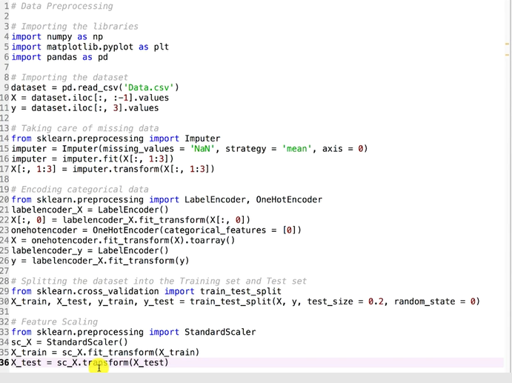
DATA PRE-PROCESSING CODE

Slide 6
SIMPLE LINEAR REGRESSION
I have company salary dataset, let me use this dataset for regression & as per the given dataset company selected 30 random peoples with years of exp & salary of an person, they asked data scientist what is the correlation of sal and experience, may be new company , new company want to build the strategies & being a data scientist you have to find out the what is the correlation & what is the best fit line and what is the business value. Being a data scientist you need to build the model
As per dataset max exp 10.5 year but if a person with exp 15 yrs how to use our model to predict the salary
Simple liner regression only 1 dependent variable and 1 independent variable
How peoples salary depends on exp as per SLR model to find the bestfit line
Constant mean the point where the line cross the verticle axes . As per graph person who don’t have any exp then his sal would be 30k that & coefficient is slope of the best fit line. As per given example – some one have 4to 5 yr exp that why he is earning of 10k extra … if coefficient is less then sal would be less if slope is greater the sal is greater
How to find the best fit line - ( ORDINARY LEAST SQUARES ) – ex.- + tells the person have 10 yr of exp 1000 dollar, Black line tells us where the person should be sitting according to the model sal about 80k dollar
Red cross – Yi (actual obersvation //actual sal) & green cross –Yi^ model observation // model predicted sal
To find the best fit line – take sum of the distance and take the sum of the square to find the minimum
Linear regre draw all possible trend line and counts the sum of squares & find the minimum of squares also called as ORDINARY LEAST SQUARES

Slide 7
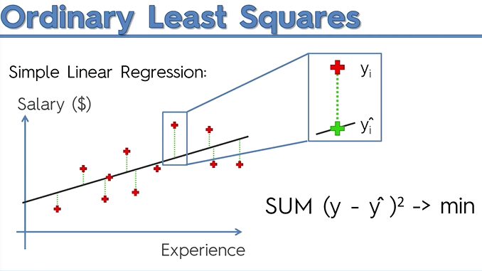
Simple Linear Regression..

Slide 8
SIMPLE LINEAR REGRESSION MODEL
1st step is importing the library like numpy,matplotlib and pandas
2nd step is data preprocess set the correct path as working directory and you should get the dataset
3rd step is training and testing the set . After complete the data preprocess you assign 30% to the test set and remember model is always build on training set only and after build the trained model then apply for test set to get the predict actually salary and predicted sal & lets compare between X_train,y_train // X-test, y_test
Simple linear regression feature scaling is not required because library will take care of it
4^{tth} step is fitting simple linear regression to the training set from SCIKIT LEARN. We will import LinearRegression class from sklearn. linear_model & we will create a regressor object
5th step – predicting the test set results , make a distinguish between y-test and y-pred.. Y-test have real sal and y-pred have predicted sal, empl real sal – 37k but model predicts 40k so keep looking that
6th step – visualize the training set & test result by plotting our observation point using matplotlib.pyplot
Real value – red dotted line & the blue line are the predicted line & our regression line was quite well to approach the linear dependence & some data-points are accuracy prediction
Next we will plot the test set result & I would say accuraycy off 75-80 & it wil predict the predicted sal & we can figure out the co-relation between these two variable

Slide 9
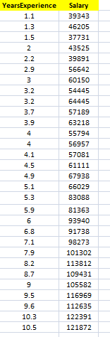
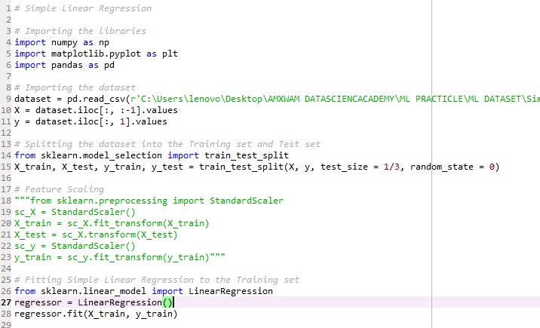
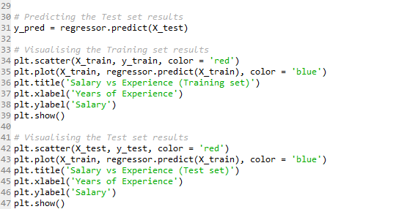
SIMPLE LINER REGRESSION CODE

Slide 10
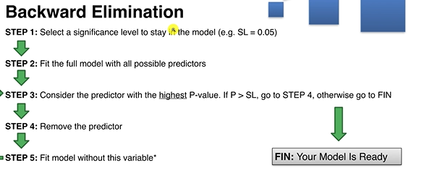
MULTIPLE LINEAR REGRESSION
The given dataset is for venture capitalist fund , Multiple linear regression dataset given about 50 companies in total and they are extract profit based on the state basis and they already spend huge money for this financial year & company spend al lot of money different portfolio. So the company hired you as data scientist to find the business problem and provide the solution and you should create a model which category is more interest to invest the spend money & which of the category company have to spend that you have to give the solution as per your model to achieve the more profit and save time
Profit are Depend variable & rest of thing are independent variable
When you create a model you always omit one dummy variable
Always remember significance lever you need to consider as 0.05 & always the remember P-value
Label encoder changed from text to number
One hot encoder is for convert to categorical data
You need to add the constant to get the correct equation
while backward elimination that’s why we have to add 1 as
constant using append function
OLS – ordinary least squaer algorithm
Endog – Dependent Var, Exdog – X_optimal var

Slide 11
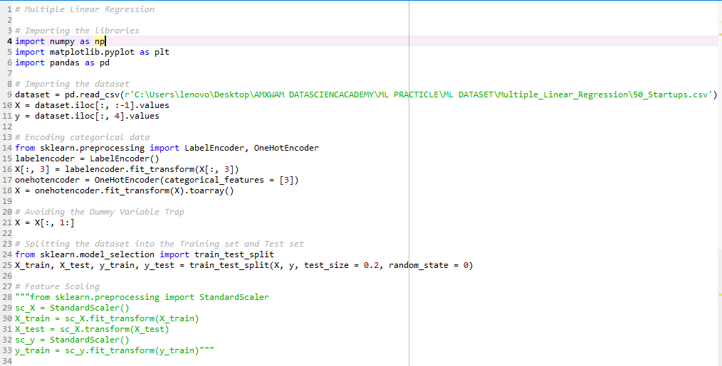
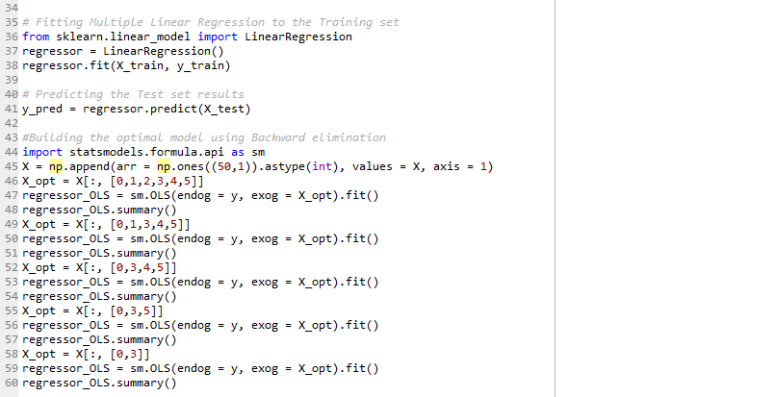
MULTIPLE LINEAR REGRESSION CODE

Slide 12
POLYNOMIAL REGRESSION
When the data is not fit with the linear at that that time we are using polynomial regression
Polynomial regressions are curve type with degree 2 slightly different between simple linear regression
We worked before SLR, MLR & now we are going to polynomial regression and from now we are going to build new non-linear regressor next polynomial regressor, svr and random forest regressor
Lets check the dataset called position salary .. Copy to the data preprocessing part
We are HR team working for big company to hire new employee and new employee is greate and good fit for the company and its going to be negotiate what going to be the future salary of new employee and company and he have 20+ yrs exp and he earned 160k annual salary in previous company and this employee is asking more then 160k however HR team called to previous employee to check what are the previous salary structure of the previous comp
Now this HR simply analysis run an excel sheet , he found that non-linear between position level and salary
At the time of analysis HR person found other relevant info that new employee has been regional manager for 2yrs now and 4 yrs to take jump from regional manager to partner , this employee is kind of half way between level 5 and level 6 & now HR will tell the using regression technique can u tell me new employee sal 160k telling lie or not
Index starting for python from 0 & to hire a previous employee where he fits to check wheather he is fall at 6.5 level is more then 160K so we are just figuring how our model can predict this lets look at this now
To compare them I build linear regression and polynomial regression and poly_reg object is going to be transfer from X matrix to X_poly, PolynomialFeatures are the class and we have to mention degree = 2 ,3,4
Real observation points are red and prediction points are in blue color
Liner output is wrong prediction because as per model ceo actual sal – 120k but models showing sal is 6k which is wrong and CEO is completely unhappy and same check with 6.5 yr ex he would be more happy
Now we will visualise using poly visualization & finally we conclude that this is honest employee

Slide 13
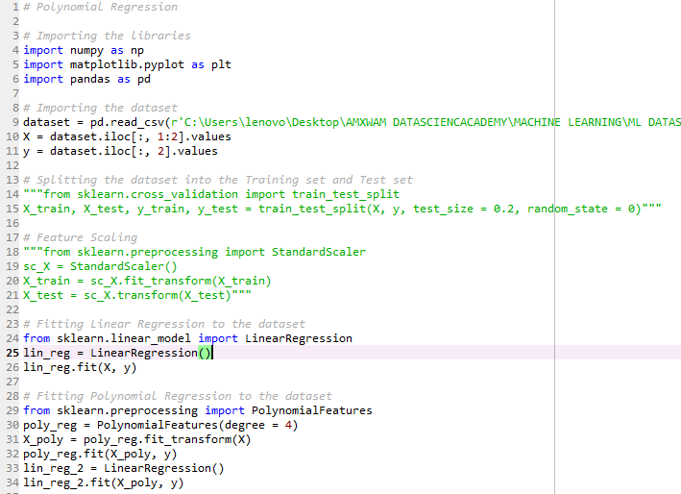
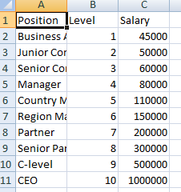
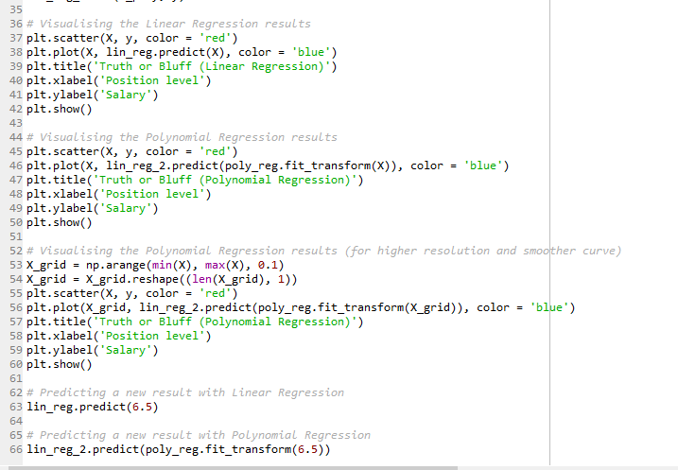
POLYNOMIAL REGRESSION CODE

Slide 14
SVR REGRESSOR
SVR support linear and non-linear regression
Instead of trying to fit the largest possible street between two classes while limiting margin violation,SVR tries to fit as many instances as possible on the street while limiting margin violations
The width of the street is controlled by a hyper parameter epsilon ( Hyper parameters are valued decided outside of model training process whereas parameters are found out during the model training. Hyper-parameter tunning is an important step in ML OR Data science model building process.)
Svr performs lin

